Slide 1
AI-Driven Personalization
Innovating Customer Engagement Through Generative AI
HEMIS - RADS

Slide 2
Introduction
This presentation explores AI-driven hyper-personalization methodologies, highlighting the transformative effect of Generative AI in enhancing customer engagement.

Slide 3
01
Objectives

Slide 4
Develop Generative AI solution
Create a robust AI system that utilizes generative algorithms to provide personalized recommendations tailored to individual customer preferences.

Slide 5
Actionable insights for businesses
Deliver insights based on data analysis, helping businesses understand their customers' behaviors and preferences, thereby enabling strategic decision-making.

Slide 6

Optimize customer engagement
Leverage AI technologies to refine interaction strategies, enhancing overall customer satisfaction and retention through personalized experiences.

Slide 7
02
Prototype

Slide 8
Description of the system
Present a complete prototype of the AI-driven recommendation system designed for real-time customer interaction, showcasing its functionalities.

Slide 9
Dynamic adaptability features
The system must adjust recommendations based on user behavior changes, personal preferences, and highlighted engagement patterns.

Slide 10

Real-time interaction capabilities
Implementing features that allow for immediate responses to user inputs, creating an engaging and fluid user experience that caters to evolving needs.

Slide 11
03
Reporting

Slide 12

Approach and methodology
Outline the systematic approach used in developing the generative AI solution, including the iterative process of design, testing, and refinement, which ensures that the model aligns with business objectives.

Slide 13
Model training and tuning
Detail the methods applied for training the AI model, including dataset preparation, algorithm selection, and hyperparameter tuning to achieve optimal performance and accuracy in recommendations.

Slide 14
Ethical considerations
Discuss the ethical aspects of implementing AI-driven solutions, focusing on data privacy, ensuring transparency in algorithms, and the importance of avoiding biases in recommendations.

Slide 15
04
Benchmarking

Slide 16

Compare with alternative models
Establish benchmarks by comparing the proposed AI model's performance against established alternatives, assessing similarities and differences in outcomes.

Slide 17
Demonstrate effectiveness
Highlight metrics used to showcase the success of the AI-driven personalization system, including user engagement rates and satisfaction surveys.

Slide 18
Performance metrics analysis
Analyze various performance metrics such as accuracy, response time, and user feedback to evaluate the overall effectiveness and efficiency of the recommendation system.

Slide 19
05
Challenges

Slide 20
Technical implementation hurdles
Identify potential technical challenges faced during the implementation phase, including integrating with existing systems and maintaining data integrity.

Slide 21
Ethical concerns
Examine ongoing ethical concerns within AI applications, ensuring adherence to regulations and addressing issues related to consumer trust and data usage.

Slide 22

Operational strategies
Outline effective strategies for operationalizing the AI-driven system, addressing training needs, system maintenance, and continuous improvement processes.

Slide 23
06
App Screen Shots

Slide 24
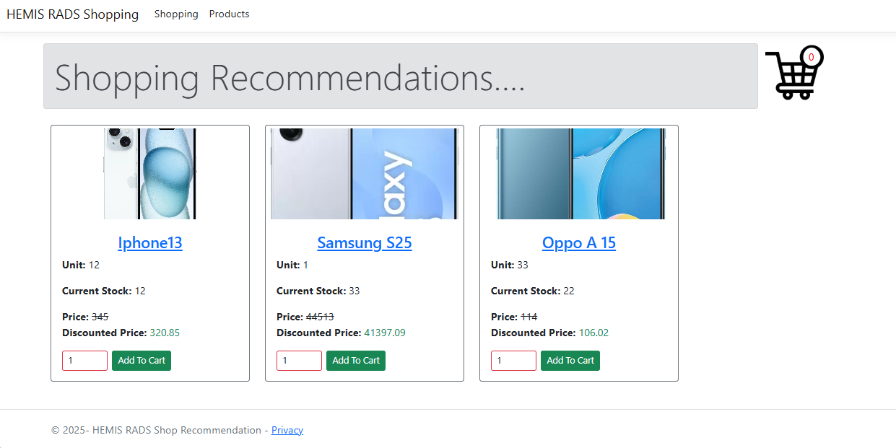

Slide 25
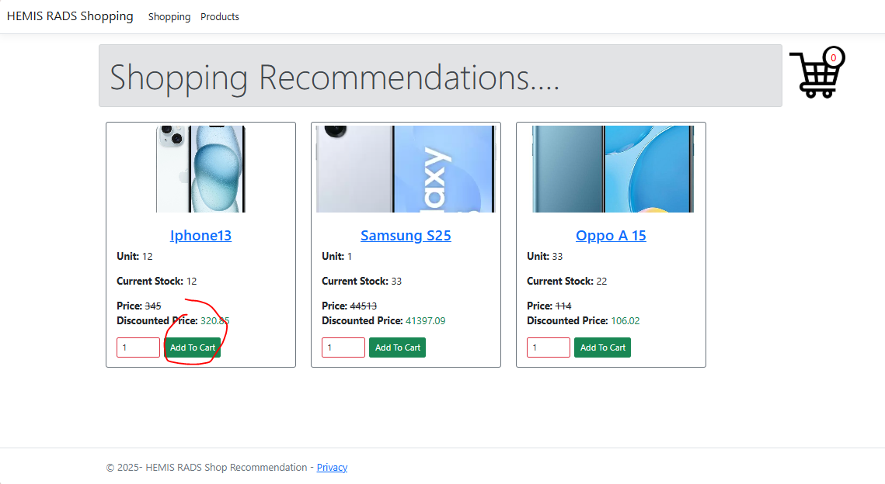
Add to Cart

Slide 26
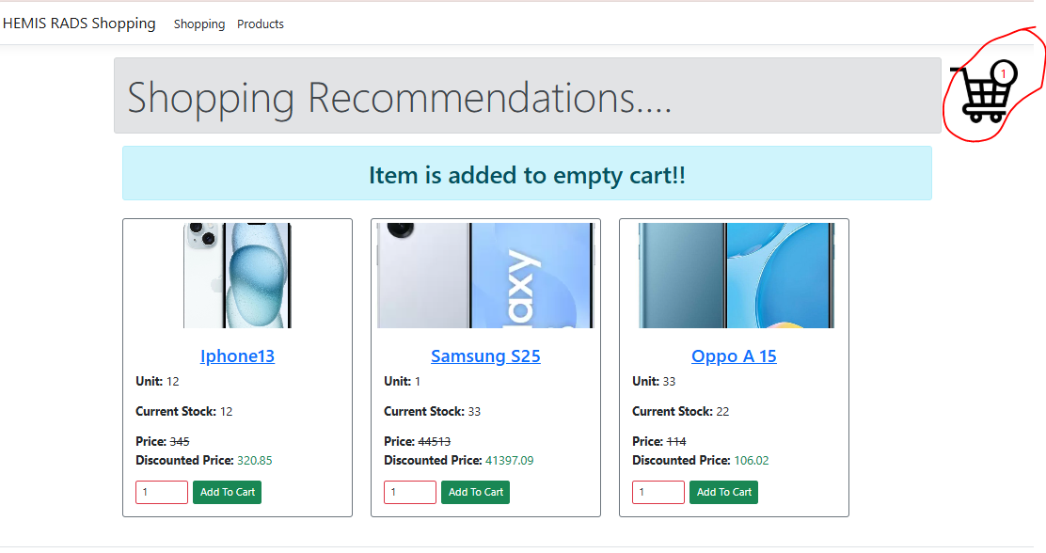
Cart position after items being added

Slide 27
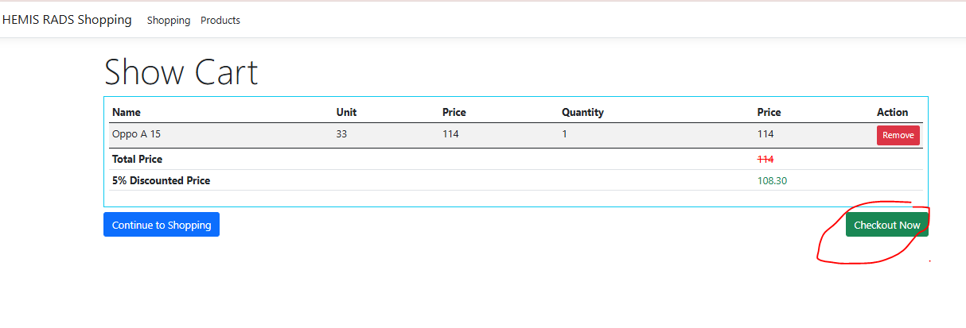
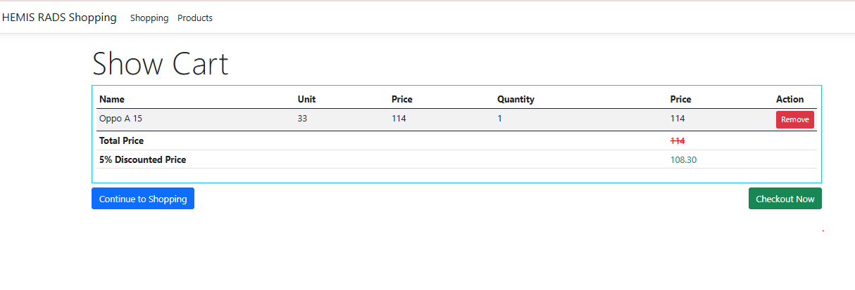
Navigate to Cart and Check-Out

Slide 28
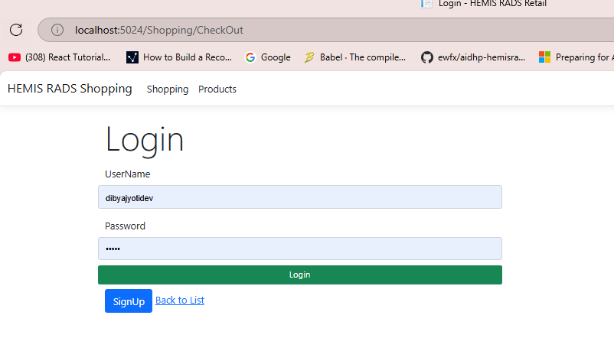
Login to execute order

Slide 29
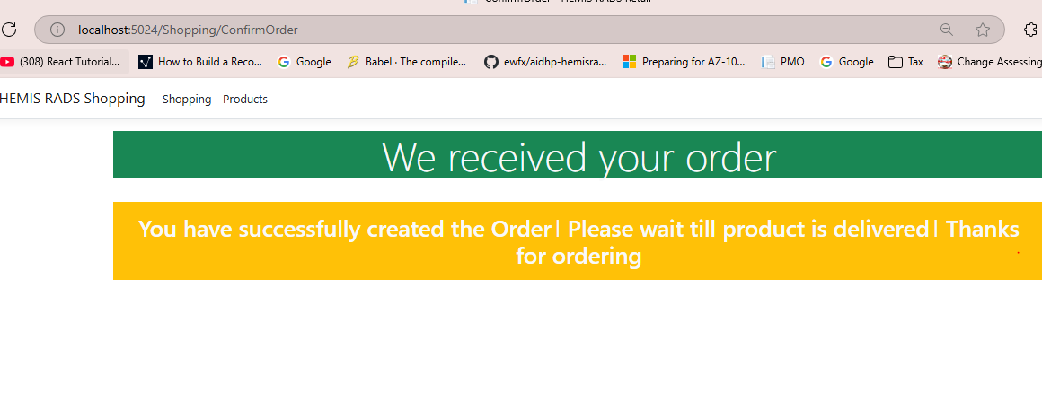
Order Execution

Slide 30

Conclusions
Summarize the critical insights gained from the presentation, reinforcing the value of AI-driven hyper-personalization in enhancing customer engagement and the need for ongoing evaluation and adaptation.

Slide 31
HEMIS-RADS
Thank you!
Do you have any questions?

